Slide 1


Survival / duration models
@ODSC
Dr Violeta Misheva
London | September 19 - 22 2018

Slide 2
Duration/survival models
They model the time spent in a state before transitioning to another state. Examples:
Duration of unemployment before finding a job
Duration of a sickness spell before recovering
Lifetime of objects (machines, lightbulbs, etc.)
Vacancy duration of a real estate object before occupation
How long will we retain a client before they churn?
Time until (re-) offending in recidivism studies
Time until divorce …

Slide 3
Duration/survival models: Example data set
Sickness and work spells of teachers
State = 1 is work, state = 2 is sickness
Dest = 0 => stop observing, i.e. censoring
School | Teacher | Spell # | Type | length | Dest | Cens | Gender | Married
1 | 3 | 1 | 1 | 175 | 2 | 0 | 2 | 2
1 | 3 | 2 | 2 | 3 | 1 | 0 | 2 | 2
1 | 3 | 3 | 1 | 4 | 2 | 0 | 2 | 2
1 | 4 | 1 | 1 | 117 | 0 | 1 | 1 | 1

Slide 4
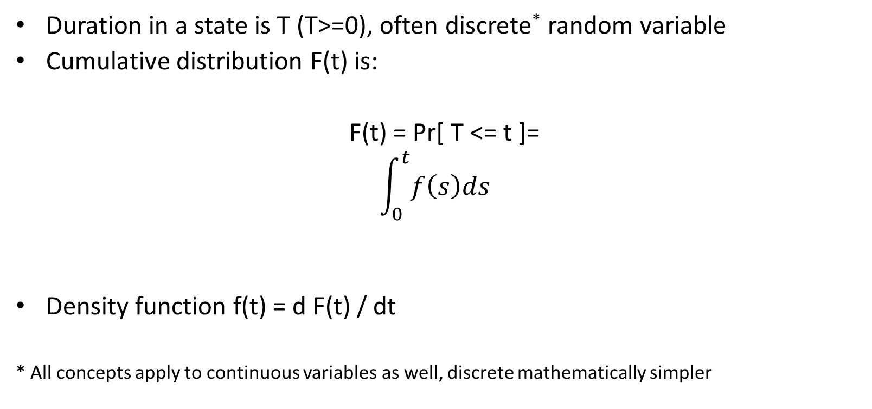
Basic concepts
Duration in a state is T (T>=0), often discrete* random variable
Cumulative distribution F(t) is:
F(t) = Pr[ T <= t ]=
$$\int_{0}^{t}{f\left(s\right)ds}$$
Density function f(t) = d F(t) / dt
* All concepts apply to continuous variables as well, discrete mathematically simpler

Slide 5
Basic concepts
Survival function S(t):
S(t) = Pr[ T > t] =
= 1- F(t)
Monotonically declining from 1 to 0 (cdf is monotonically increasing); S(∞) = 0
We do not observe the true survival curve of a population, we can only use the data to estimate it.

Slide 6
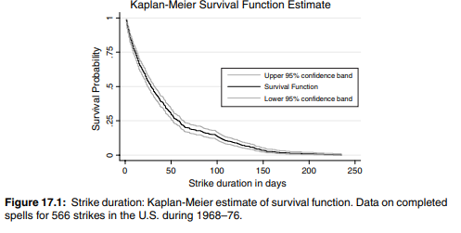
Basic concepts: example survival function

Slide 7
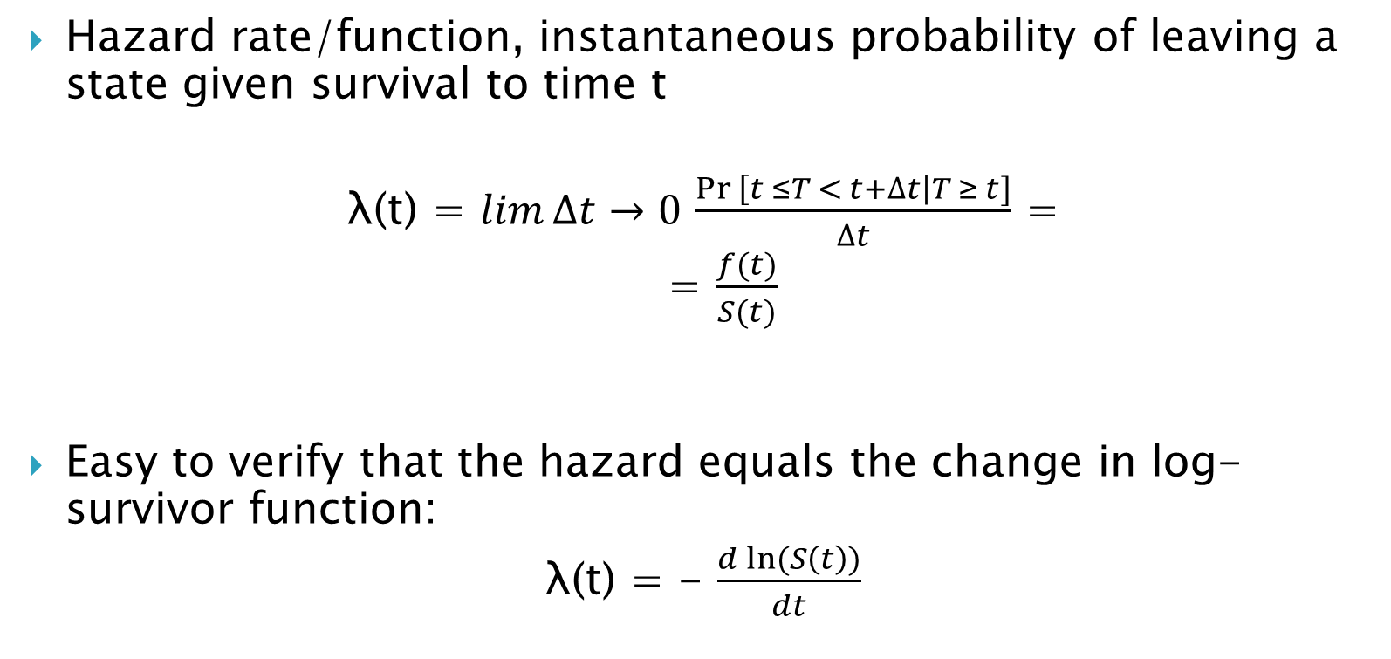
Basic concepts
Hazard rate/function, instantaneous probability of leaving a state given survival to time t
λ(t) = $\lim{∆t→0}$ $\frac{\operatorname{Pr}\left[t ≤T < t+∆t\right|T ≥ t]}{∆t}$ =
= $\frac{f(t)}{S(t)}$
Easy to verify that the hazard equals the change in log-survivor function:
λ(t) = - $\frac{d ln⁡(S\left(t\right))}{dt}$

Slide 8
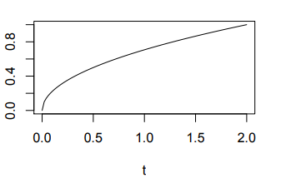
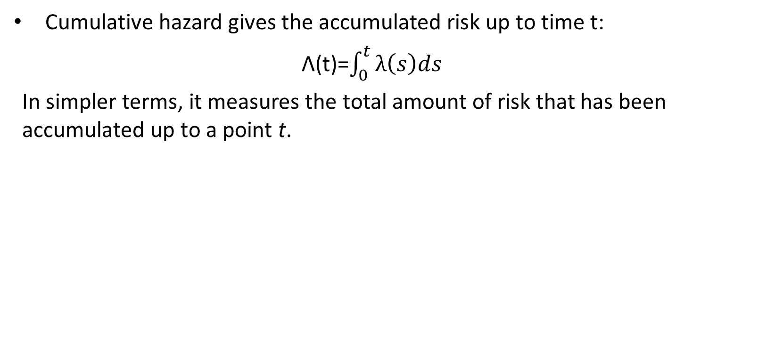
Basic concepts
Cumulative hazard gives the accumulated risk up to time t:
Λ(t)=$\int_{0}^{t}{λ\left(s\right)ds}$
In simpler terms, it measures the total amount of risk that has been accumulated up to a point t.

Slide 9
Basic concepts
The duration distribution is completely characterized by the hazard rate λ
F, S, f and λ are all unique characterizations of the distribution of T (can derive one from the other)
The hazard rate is also closest to what you want to know

Slide 10
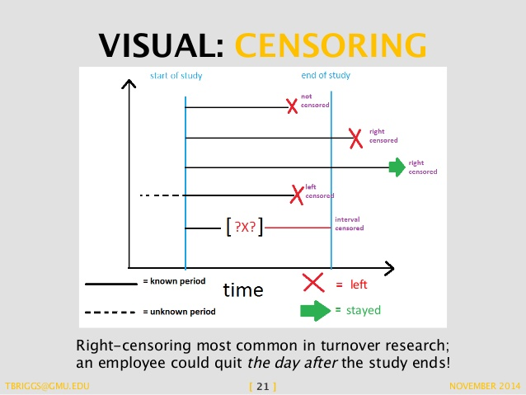
Censoring
Most common is right censoring (observe spells from time 0 until a censoring time c). We assume censoring is non-informative about the event;
Q: why shouldn’t we ignore
censorship?

Slide 11
Estimating the survival and hazard
We can use non-parametric methods (Kaplan-Meier)
(Semi-) parametric: by making assumptions about the distribution, common being:
Weibull
Exponential
Gamma
Log-normal

Slide 12
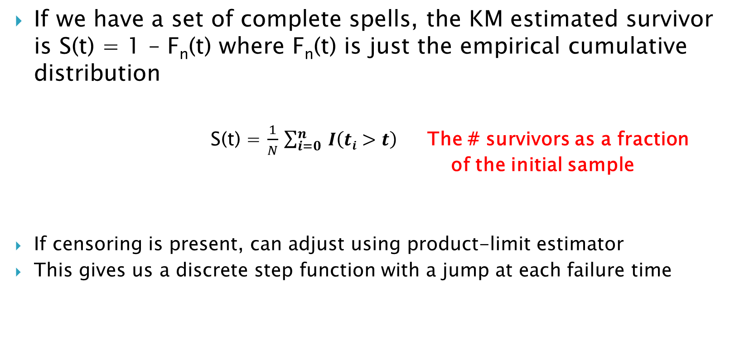
Non-parametric: Kaplan-Meier
If we have a set of complete spells, the KM estimated survivor is S(t) = 1 – F_{n}(t) where F_{n}(t) is just the empirical cumulative distribution
S(t) = $\frac{1}{N}$ $\sum_{i=0}^{n}{ I\left(ti>t\right)}$ The # survivors as a fraction of the initial sample
If censoring is present, can adjust using product-limit estimator
This gives us a discrete step function with a jump at each failure time

Slide 13
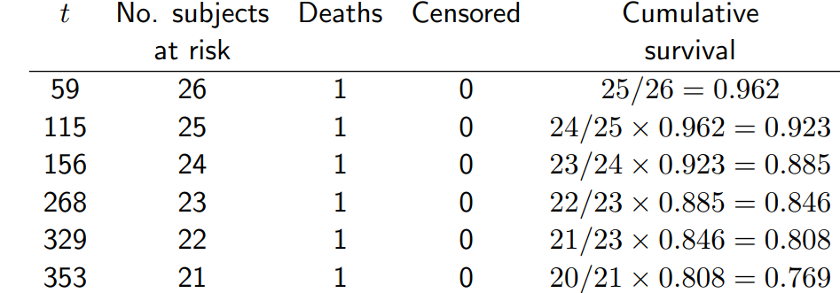
Non-parametric: Kaplan-Meier, example table

Slide 14
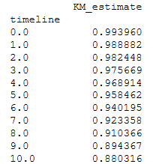
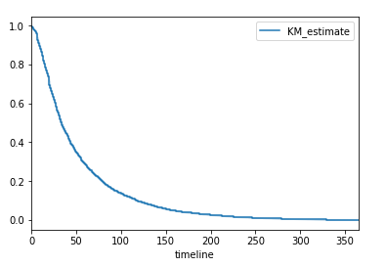
Non-parametric: Kaplan-Meier, example graph
In Python, package lifelines

Slide 15
Non-parametric: Kaplan-Meier, example graph
In Python, package lifelines
Y-axis is prob a house is still vacant after t periods; Most rented out in less than 100 days

Slide 16
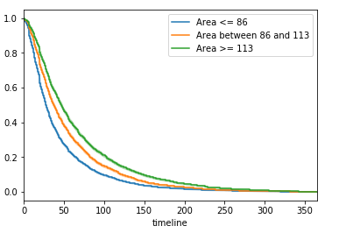
Non-parametric: Kaplan-Meier, example graph
Common and useful to do a logrank test (testing the survival for different groups of the population (KM average for the population))
-> Difference in the vacancy rate of apartments based on their area

Slide 17
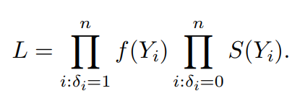

Parametric estimation
WHEN: If we want to estimate the distribution of S(t) more precisely, as well as λ(t) and Λ(t), and to account for the effect of the covariates
Estimated using Maximum Likelihood (MLE); If the outcome Y_{i} is not censored, the i-th observation contributes f(Y_{i}) to the estimation; if censored, the i-th observation contributes P(y > Yi) to the likelihood (we only know that they survived past the last observation time);
Joint likelihood:
where

Slide 18
Parametric estimation: Mixed proportional hazard
To estimate the model, we need to make assumptions about the f(t) and S(t) (and from them, obtain the hazard)
Popular specification is the MIXED PROPORTIONAL HAZARD model:
λ(t | X, γ) = θ(t). λ₁( X, β). γ
Common baseline hazard, time-dependent
Regressor function, varying with matrix covariates X
Unobserved heterogeneity (i.e. individual effect)

Slide 19
Parametric estimation: Mixed proportional hazard
It’s proportional hazard because the ratio between hazard rates of two subjects is independent of time(i.e. proportional to THE BASELINE HAZARD!); the rate of change over time doesn’t depend on X (i.e. the same rate of change for groups in our sample) => a strong assumption, could be different in reality
If we assume no unobserved heterogeneity (γ== 1), we need to specify the regressor and baseline hazard

Slide 20
Parametric estimation: Mixed proportional hazard
λ₁( X, β) = exp (X’ β)
Popular specifications for the baseline hazard:
Exponential: T~ Exp(c) , f(t) = ce^{-ct}
θ(t) =c , Λ(t) =ct (constant hazard function; prob to survive does not depend on how long you’ve been alive)
S(t) = e^{-ct}
Weibull: generalization of the exponential distribution (shape α and scale c)
F(t) = 1 – e^{(–ct)^α}
θ(t) = cαt^{α -1}

Slide 21
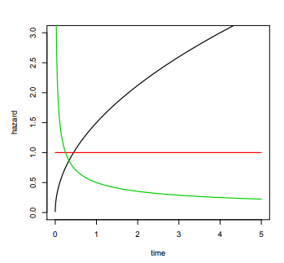
Parametric estimation: Mixed proportional hazard
Weibull allows for monotonic relationship (either increasing or decreasing hazard rate)
If α = 1, it reduces to the exponential case, if α > 1, the risk/hazard increases over time, if α <1, it decreases over time
Α >1
Α =1
Α <1

Slide 22
Semi-Parametric estimation: Cox proportional hazard
If we misspecify the duration, this could lead all the coefficients to be inconsistent (Weibull and exponential too restrictive) => try more flexible approaches such as Cox PH, where we do not make strong assumptions about the baseline hazard
Likelihood is based on rank order (rank durations in ascending order);
The baseline hazard left unspecified, functional form of
λ₁( X, β) = exp (X’ β), which allows for interpretation of β and ensures exp(X’ β) > 0

Slide 23
Semi-Parametric estimation: Cox proportional hazard
If the j-th regressor x_{j} changes by one unit and all others are unchanged, then
λ (t| X_{new}, β) = θ(t). λ₁( X’ β + β_{j})
= exp(β_{j}). λ (t| X, β)
the new hazard is the exp(β_{j}) times the original hazard (in broad terms, changes in regressors have multiplicative effects on the original hazard)
Knowledge of β is required but not of the baseline hazard θ(t)

Slide 24
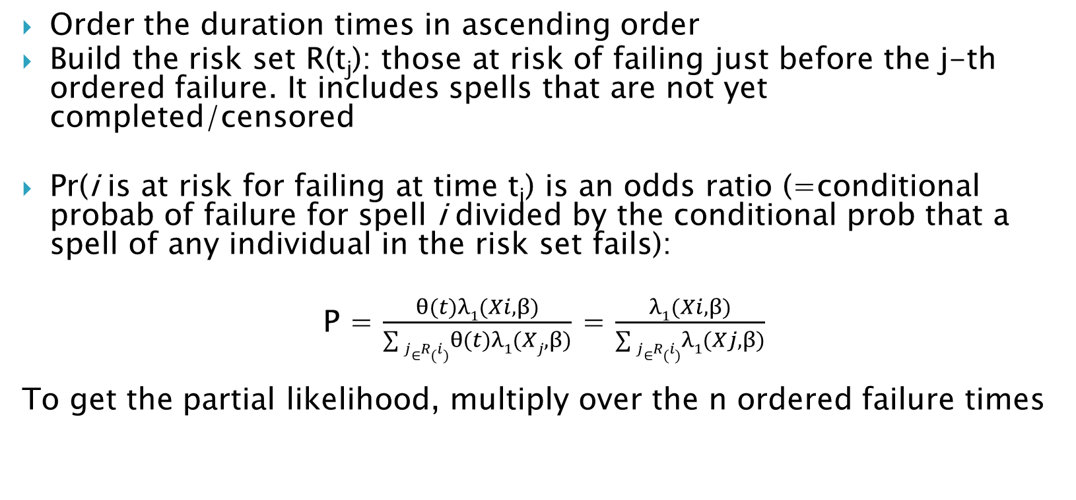
Cox proportional hazard: Partial Likelihood
Order the duration times in ascending order
Build the risk set R(t_{j}): those at risk of failing just before the j-th ordered failure. It includes spells that are not yet completed/censored
Pr(i is at risk for failing at time t_{i}) is an odds ratio (=conditional probab of failure for spell i divided by the conditional prob that a spell of any individual in the risk set fails):
P = $\frac{θ(t)λ1(Xi, β)}{\sum{j∈R(i)}θ(t)λ1(Xj, β)}$ = $\frac{λ1(Xi, β)}{\sum{j∈R(i)}λ1(Xj, β)}$
To get the partial likelihood, multiply over the n ordered failure times

Slide 25
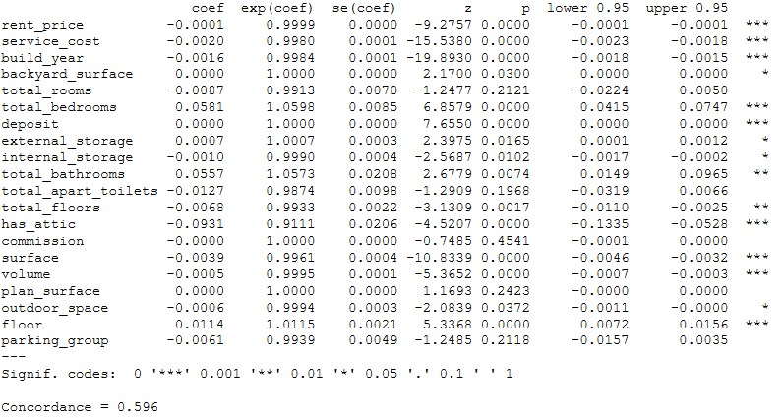
Cox proportional hazard: Example
In Python, lifeline package allows you to fix a Cox Proportional hazard model (CoxPHFitter)

Slide 26
Cox proportional hazard: Example
You have signs and significance level of coefficients (se, confidence intervals, etc.)
A measure of performance is the concordance , calculated in the following way:
Form all possible pairs of observations of the data
Omit pairs where one is censored; get total number of permissible pairs
Count 1 for each pair where the short event had also the worse predicted outcome; count 0.5 if the predicted outcome are tied.
Sum the counts over all permissible pairs
C = Sum of the counts / total number of permissible pairs

Slide 27
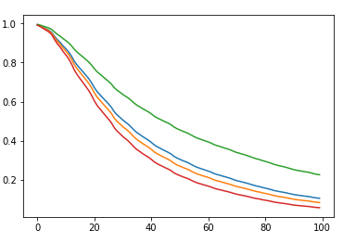
Cox proportional hazard: Example
You can then predict the survival rate of unseen data, or aggregate it and predict the expected mean (i.e. when is the most likely failure time for each new observation)
Survival functions for the
first 100 periods of 4
different observations

Slide 28
Random Survival Forest
Inherits from the classical nice properties of random forests;
It is adaptive to the data and virtually assumption free
Algorithm:
Draw n bootstrap samples from the data
Grow a tree for each bootstrapped data set, at each node use only m predictors for splitting on. Split on a predictor using a survival splitting criterion. The goal is to maximize the survival differences across daughter nodes.
Grow the tree to the full size given certain parameter restrictions (such as size of nodes)
Calculate the cumulative hazard by combining information from all n trees
Compute OOB error rate derived using the first b trees, b = 1, 2, …n

Slide 29
Random Survival Forest
Package in R (randomSurvivalForest), not in Python yet
Splitting rules:
Log-rank splitting rule (measure of node separation)
A conservation of events
A log-rank score rule
Fast approximation of the log-rank splitting rule
You can also calculate the cumulative hazard for the ensemble (using all estimators), and the OOB estimator (only for those observations where i is an OOB)
Performance estimate: error rate = 1- concordance rate

Slide 30
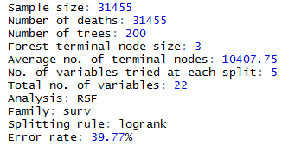
Random Survival Forest
Package in R (randomSurvivalForest), example output

Slide 31
Survival models: conclusions
Random Survival forest often do not outperform Cox PH model
If you have a duration type of a problem, instead of predicting a probability for an event happening at a given time, consider modelling the whole distribution, i.e. how that probability changes over time
Non-parametric models very flexible (no assumptions) but features not taken into account
Cox proportional hazard model more flexible (we don’t assume a distribution for the baseline hazard), gives you coefficients for the features but the proportional hazards assumption is strong

Slide 32
Survival models: conclusions
Basic concepts introduced here can be extended: deal with the unobserved heterogeneity (can also try to model it) by using mixture hazard models
Have multivariate duration models (competing risks when we try to model simultaneous modelling of multiple transitions, i.e. joint specification and estimation of two or more hazard rates)

Slide 33
Thank you for the attention!
Email: mishevavioleta@gmail.com
LinkedIn: Violeta Misheva
(linkedin.com/in/violeta-misheva-phd-29674588)

Slide 34
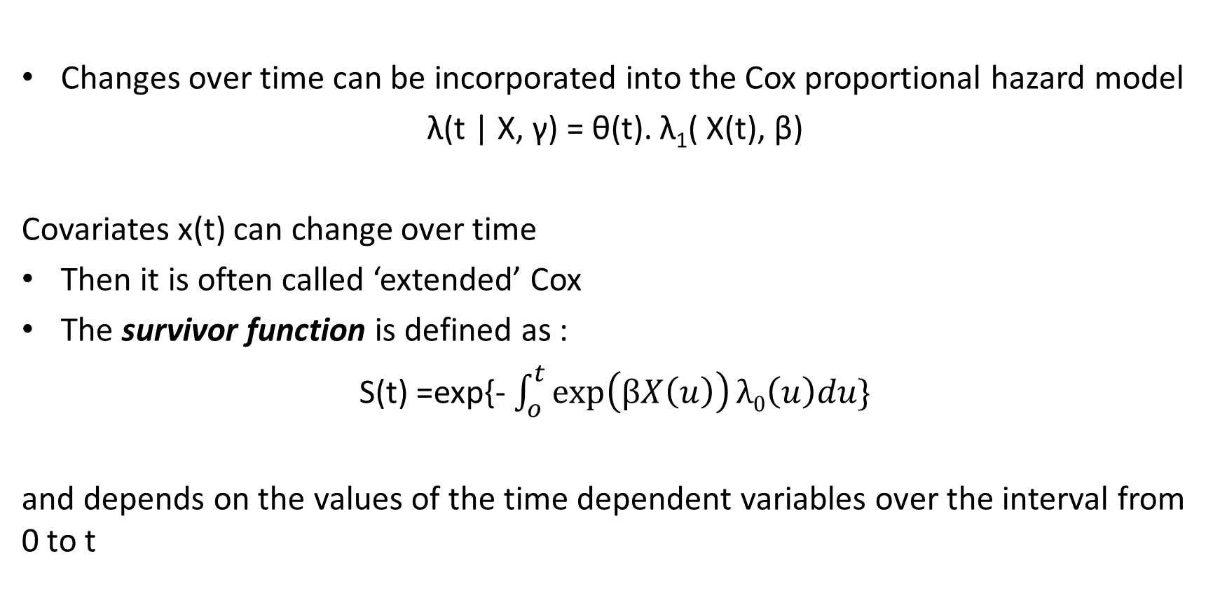
Appendix 1: Time-varying covariates
Changes over time can be incorporated into the Cox proportional hazard model
λ(t | X, γ) = θ(t). λ₁( X(t), β)
Covariates x(t) can change over time
Then it is often called ‘extended’ Cox
The survivor function is defined as :
S(t) =exp{- $\int_{o}^{t}{\exp\left(βX\left(u\right)\right)λ0\left(u\right)du\}}$
and depends on the values of the time dependent variables over the interval from 0 to t
Novotel London West (1 Shortlands, London W6 8DR)

Slide 35
Appendix 1: Time-varying covariates
When is it most appropriate to use a Cox model with time-dependent variables?
When important covariates change during a study (for example, we are interested in predicting the risk for a cardiovascular problems and an important feature might be the number of cigarettes smoked per day)
In cross-over studies to indicate a change in treatment

Slide 36
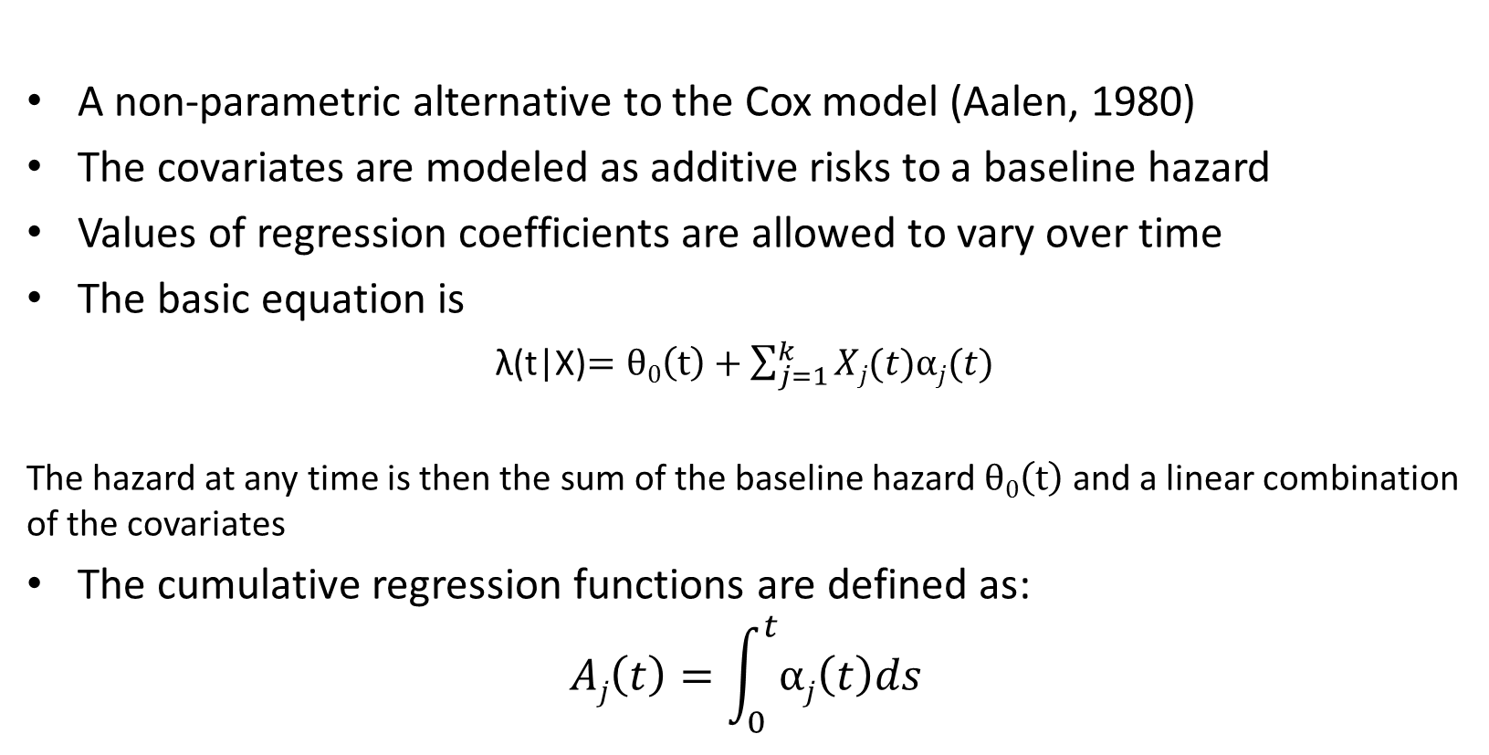
Appendix 2: Aalen-additive models
A non-parametric alternative to the Cox model (Aalen, 1980)
The covariates are modeled as additive risks to a baseline hazard
Values of regression coefficients are allowed to vary over time
The basic equation is
λ(t|X)$=θ0\left(t\right)+\sum_{j=1}^{k}{Xj(t)αj(t)}$
The hazard at any time is then the sum of the baseline hazard $θ0\left(t\right)$ and a linear combination of the covariates
The cumulative regression functions are defined as:
$$Aj\left(t\right)=\int_{0}^{t}{αj\left(t\right)ds}$$

Slide 37
Appendix 2: Aalen-additive models
The cumulative regression functions are plotted against time and give a description of how the covariates influence the survival over time.
It is therefore the change in the cumulative functions, i.e. the slope that is of primary interest
Note: The hazard rates are not restricted to be non-negative numbers with the Aalen-additive model, which could lead to the survival function not monotone over time but increasing

